Slide 1
Visualizing and analyzing hinode xrt metadata
Greg Woelki
Nicole schanche
Kathy Reeves

Slide 2
Overview
Hinode XRT
XRT Pointing Visualization/Planning Tool
XRT Flare Imaging Performance Analysis
Notes:
My work this summer focused on working with metadata from the Hinode X-Ray Telescope (XRT). My internship was split into two main projects: first, creating a tool to help with XRT planning, and second, analyzing the performance of XRT in imaging solar flares.

Slide 3
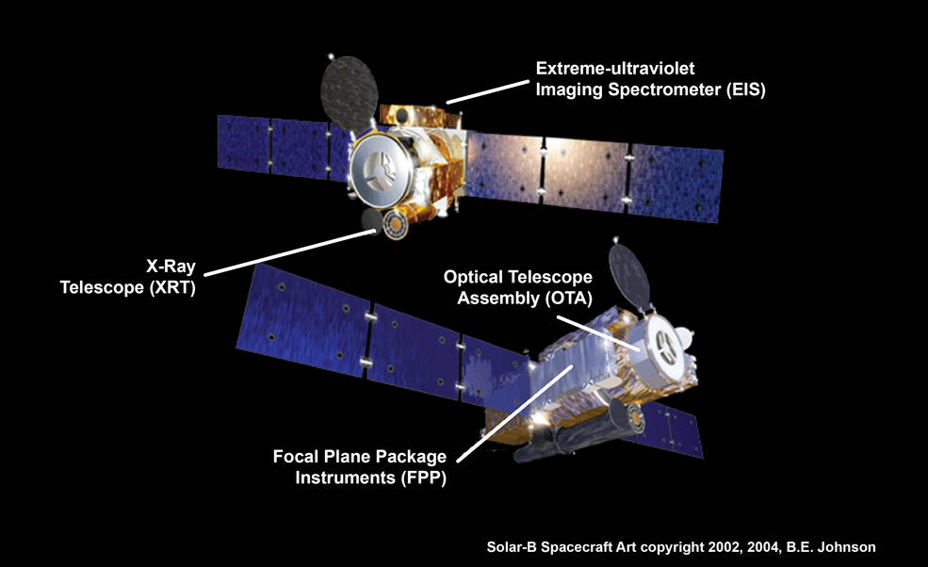
Hinode
http://www.nasa.gov/sites/default/files/styles/full_width/public/thumbnails/image/hinode_spacecraft_0.jpg
Notes:
This is the satellite Hinode. It is a Japanese mission with collaboration by US and UK scientists. It was launched in September of 2006 into a polar orbit. It has three main instruments, the Solar Optical Telescope (SOT), the Extreme-ultraviolet imaging Spectrometer (EIS), and the X-Ray Telescope (XRT).

Slide 4
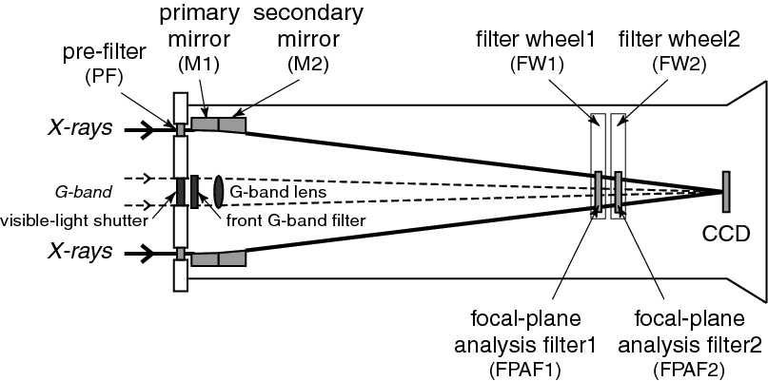
XRT
http://inspirehep.net/record/877387/files/fig_optical_elements.png
Notes:
This is a diagram of XRT. X-rays enter by passing through the ring shaped pre-filter in the front (left hand side) and are reflected at grazing angles of incidence by the primary mirror (parabolic) and then the secondary mirror (hyperbolic). The light passes through either 1 or 2 filters before subsequently depositing its energy to the 2048 x 2048 pixel CCD sensor array, from which intensity values are read out with varying exposure lengths. Note that, in the center of the instrument, there is a visible light shutter. For taking visible light calibration images, the shutter is opened, the first filter wheel is set to the open position, and the second filter wheel is set to G-band, which is a visible light lens.

Slide 5
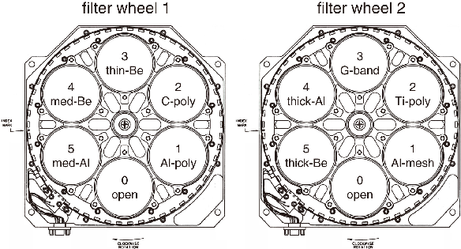
XRT
http://inspirehep.net/record/877387/files/fig_FW.png
Notes:
This diagram show the variety of available filters in XRT.

Slide 6
XRT
Synoptics
Pointing plans – tracking
Flare Detection Patrol Images
Flare Response Images
Focus Mode
Eclipse season
Notes:
XRT has a 2048 x 2048 CCD with a resolution of 1.0286 arcseconds per pixel. This means that, when pointing at the center of the sun, XRT has a large enough field of view to image the entire sun at once. Unfortunately, the other two instruments on Hinode, SOT and EIS, have smaller fields of view; in order for SOT and EIS to get worthwhile data, Hinode has to point at interesting places on the sun. This means that XRT cannot usually see the entire sun in its FOV because Hinode follows what’s known as a pointing plan. These plans are put together in advance by scientists and are usually three days long. In general, these plans consist of tracking a chosen active region for a few hours at a time. Once every 12 hours, however, Hinode points at sun center so that XRT can take a few synoptic images. Synoptics are special kinds of full sun images. During most of its operation, however, not only is XRT unable to take full sun images because of the pointing of Hinode, it is also unable to take full FOV images because of the limited amount of data that can be stored and then sent back to Earth. Therefore, most XRT images actually have FOVs of only a few hundred arcseconds. This is accomplished by only reading out data from a small portion of the CCD. So, then, what is the point of the large CCD? Just synoptics? No, XRT actually does take many full FOV images – hundreds of thousands of them, in fact. These are called Flare Detection Patrol images (FLD patrol images), and they are binned 8x8 because of the restrictions on the amount of data XRT can collect. This means that the values of each block of 64 pixels are averaged together, creating a full FOV image that is only 256 x 256 pixels. In general, one of these FLD patrol images is taken every 30 seconds. An onboard algorithm automatically compares these images, looking for changes in brightness that indicate that a solar flare is occurring. When the Flare Detection (FLD) Trigger is tripped, XRT starts reading out from the part of its CCD in which the change in brightness occurred, taking flare response images. Because of the background brightness, this algorithm only detects flares of moderate strength and higher, roughly from class C5 and up. Keep in mind, however, that this can only work for flares that occur within the FOV of the CCD. Other important things about the general operating procedures of Hinode and XRT are focus mode and eclipse season. Focus mode is when pointing plans are made for periods of 7 days instead of 3 days. Focus mode is often used in conjunction with eclipse season, which is the time in the Earth’s orbit in which Hinode’s view of the sun is regularly eclipsed by the Earth in its polar orbit.

Slide 7
XRT Pointing Visualization/Planning Tool
Python 2.7
Iterates through synoptics
Displays synoptics with additional data:
Pointing fields of view
Flare response field of view and number of images
Flares – labeled by class
Frames assembled into 1 FPS video for help planning
Notes:
My first project this summer was creating a tool to help visualize XRT operations and assist in planning XRT pointings. I used Python 2.7 to create this tool. The program iterates through synoptic images taken during the specified time period and annotates them with additional data. These frames are then assembled into a low frame rate video.

Slide 8
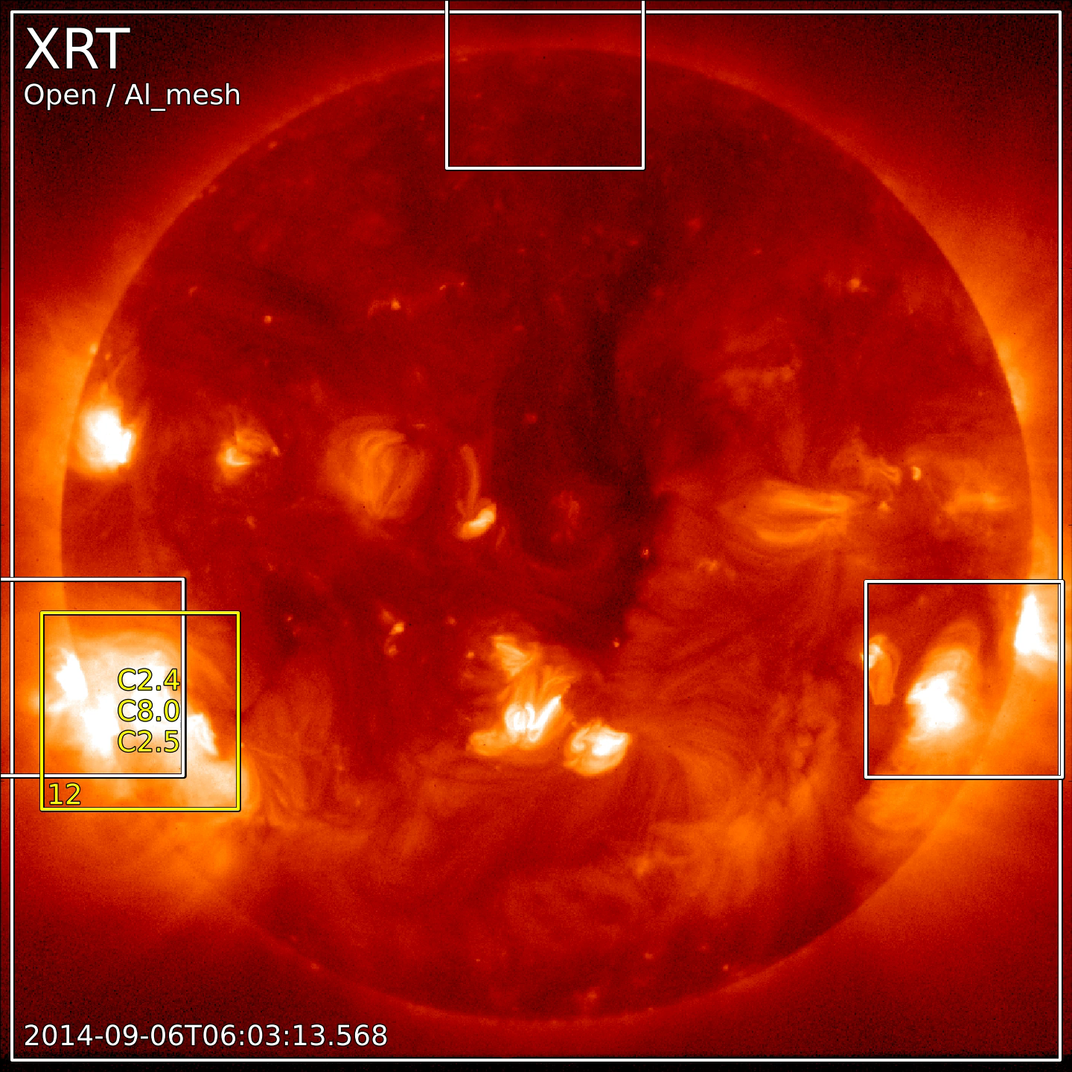
Notes:
This video walks through a couple of weeks of XRT observations, showing FOVs of both normal data collection (white) and FLD response data (yellow) in conjunction with the locations of solar flares, labeled by GOES flux rating. All of this is overlaid on the synoptic that was taken in the middle of the 12 hour period in question. The information necessary to create each frame comes from a variety of sources, including locally stored data files (for both synoptics and regular images) as well as information from online sources such as Hinode pointing plan files, the XRT flare trigger response list, and the Hinode Flare Catalog. This video provides a small snapshot of the flare imaging performance of XRT. One can see that, while XRT misses many B flares and weak C flares, it tends to perform better at capturing the more powerful (and typically more scientifically interesting) flares. Along these same lines, note how the FLD response very rarely triggers for weak flares.

Slide 9
Analysis of XRT Flare Imaging Performance
First analyzed performance with respect to the location of flares
Imaging probability curves
STEREO
FLD response likelihood vs. location
FLD response likelihood vs. flare class
Focus Mode
Eclipse Focus Mode
Normal Mode
FLD failure reasons vs. location
FLD failure reasons vs. class
CCD coordinates location
Notes:
My next step was to analyze XRT’s flare imaging performance. I did this in a multitude of ways, including those listed on this slide.

Slide 10
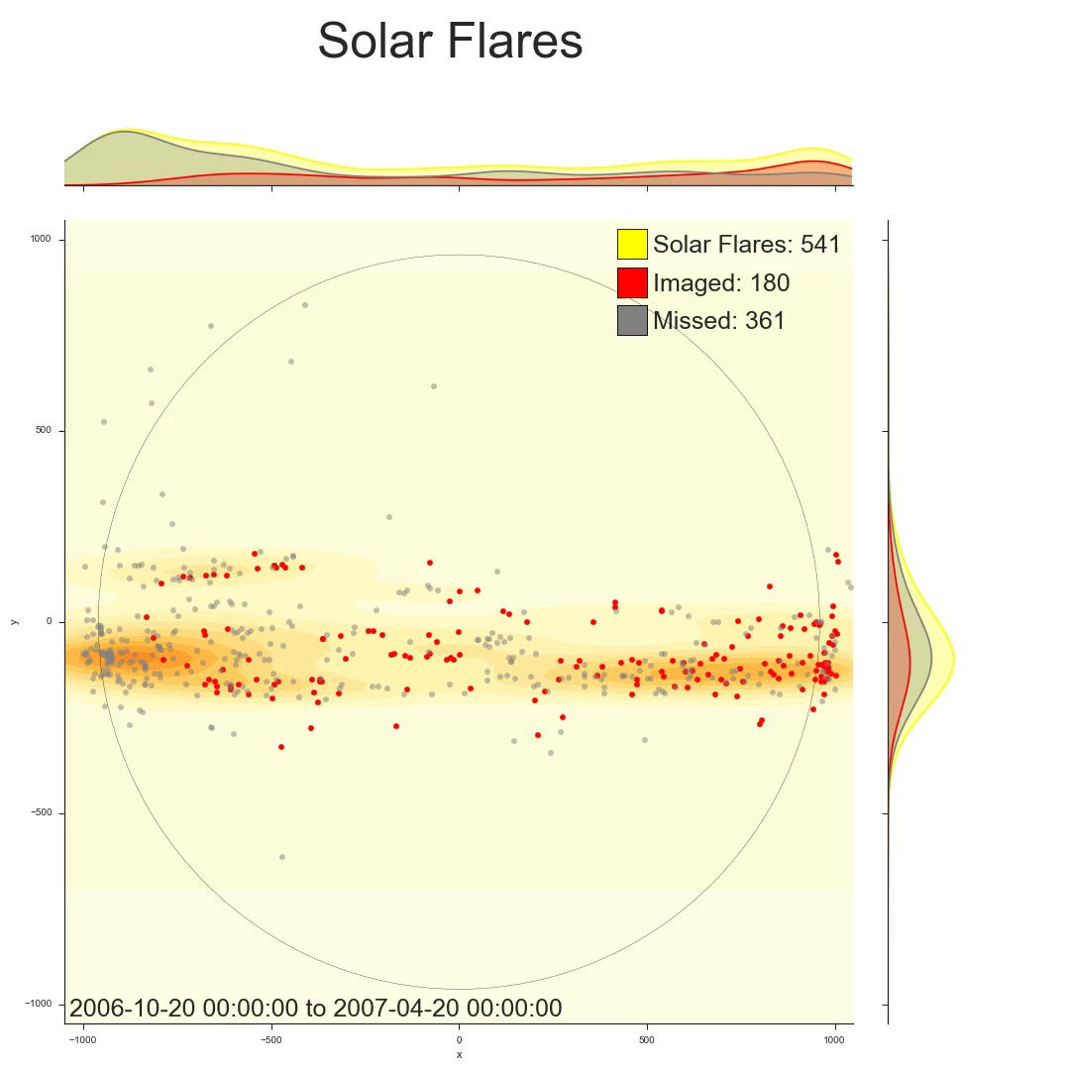
E
W
Notes:
The first approach I took to this analysis was in visualizing the success of XRT in imaging flares with respect to the location of the flares. This video shows the flare imaging history of XRT over its 9 year lifetime. Each frame depicts the performance of the XRT over a 6 month long "window" into the past. This window shifts forward by one day in each successive frame. A scatter plot details the locations of all B, C, M, and X class solar flares that occurred in the time windows; a red dot represents a flare that was imaged by XRT, while a grey dot represents a flare for which XRT failed to collect any data. A heatmap behind the scatter plot indicates the density of all flares across the disk of the sun, while spline curves on the top and right hand sides of the plot show the distribution of flares that were captured and were missed, as well as the overall total number of flares, in the E-W and N-S directions. The source for the flare locations as well as whether the flares were imaged is the XRT Flare Catalog.
Note that XRT tends to miss the highest percentage of flares on the east limb (left hand side, unlike the convention with Earth). This is because active regions move from east to west across the disk of the sun as the sun rotates. This rotation is apparent in the video in the way in which swaths of flares appear from east to west as the active regions responsible for them make their paths across the disk of the sun. If an active region appears on the east limb from behind the sun, the XRT planners are less likely to respond in time to catch any flares that may occur while the region is still on the east limb. In contrast, XRT planners have been keeping an eye on any active regions in the middle or on the right hand side of the disk for some time, and their pointing plans are therefore better at capturing flares that occur in these regions.
This video spans 9 years of solar history, capturing a substantial portion of the 11 year solar cycle. Note that the quantity of flares decreases as we approach solar minimum in 2008, increasing from there until solar maximum in 2013 and subsequently beginning to decrease again until present day. Also make note of the locations of the flares: around solar minimum, flares occur in narrow bands above and below the equator, but, as solar maximum approaches, these bands widen, covering an expanse that reaches closer to the poles. One can also observe in this video that the southern hemisphere lags behind the north in the solar cycle, reaching both its minimum and maximum at later times. Additionally, keep in mind that the eastern and western limbs of the sun typically have higher concentrations of flares than the middle because, while the sun is being depicted as a disk, it is actually a three dimensional sphere. This means that an area on the edge of the disk corresponds to a larger piece of surface area on the sphere than an area of the same size on the center of the disk does.

Slide 11
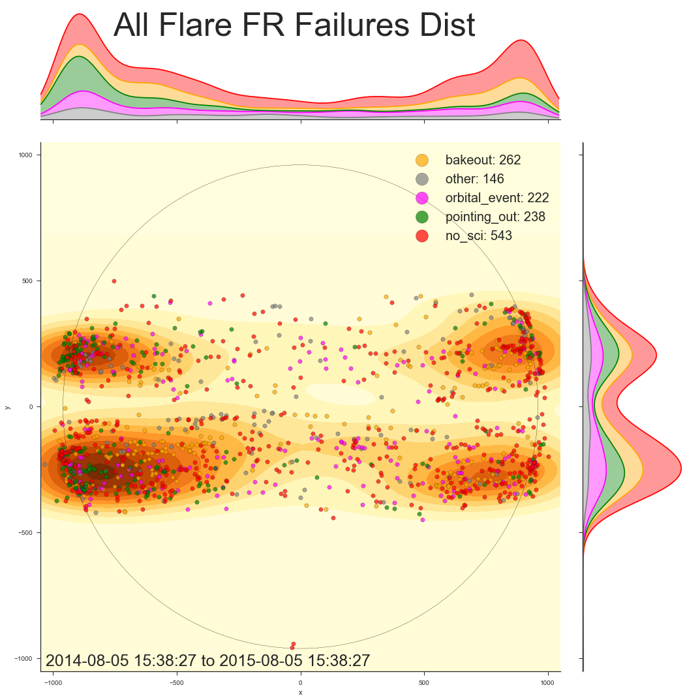
analysis
Notes:
This figure is an attempt to confirm that the east limb performance disparity which can be observed in the flare imaging history video is a result of spending a lot of time pointing away from the east limb. The different colors are used to display the reason that each of these imaging failures occurred. I grouped the majority of the reasons into an “other” category to keep them from cluttering up the diagram. The major four reasons are no_sci, bakeout, pointing_out, and orbital_event. The label ‘no_sci’ means that science images were not being taken while the flare happened. ‘Bakeout’ refers to what are known as CCD bakeouts. For three days once every two weeks, a heating coil is used to essentially boil off any contaminants that have gathered on the CCD sensor array. The CCD performs poorly at these temperatures, so no images are taken. The third most common reason is ‘pointing_out.’ This refers to when the flare didn’t occur within the FOV of XRT’s CCD, so it wasn’t possible for it to be imaged. Lastly, ‘orbital_event’ is the fourth most common reason. This refers to several different things, such as when XRT stops taking data while passing through regions of high radiation in its orbit and when Hinode passes behind the Earth in its orbit during eclipse season so that it cannot image the sun. Now, all of the failure reasons are reasonably symmetric in both axes except for one: pointing failures. There are far more pointing failures on the east limb than the west limb. This is consistent with our hypothesis derived from the previous figures.

Slide 12
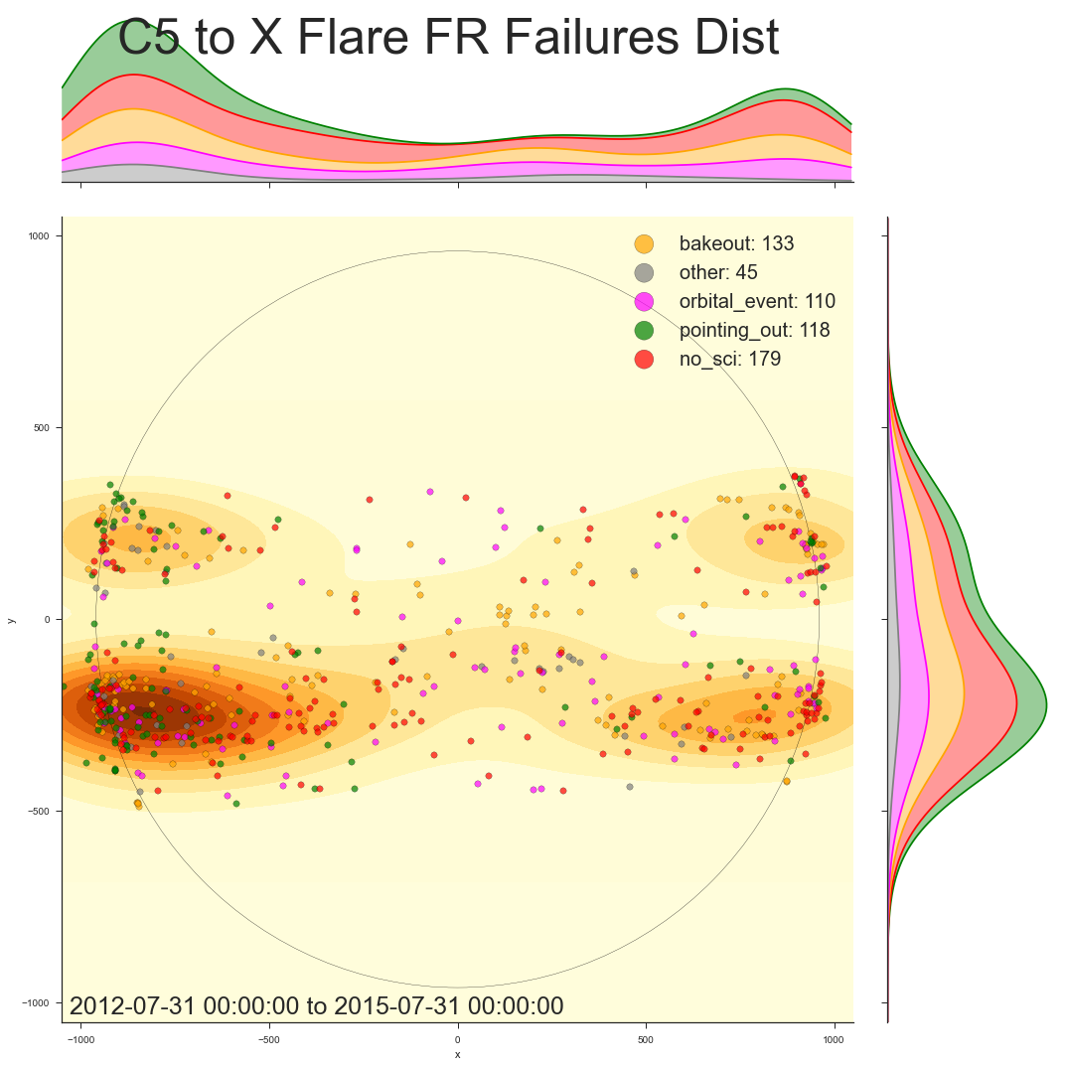
Analysis
Notes:
This is the same kind of plot, but it is restricted to flares of at least class C5. Note that, because these flares are less common, I expanded the date range to 3 years instead of 1 to get more data points. Unfortunately, the east limb imaging disparity exists among the more scientifically interesting flares as well. One can very clearly see that pointing failures are to blame once again.

Slide 13
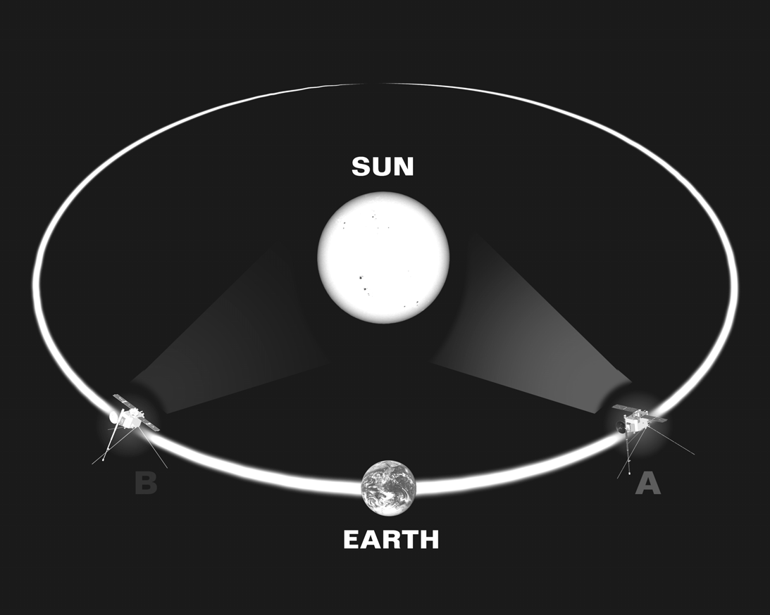
STEREO
http://cse.ssl.berkeley.edu/stereo_solarwind/img/missionsFolder/STEREO_orbit.bmp
Notes:
STEREO is a mission that has potential to help fix the east limb disparity. In 2006, two satellites (named A and B for “Ahead” and “Behind” respectively) were launched into highly eccentric orbits around the Earth. These orbits were precisely calculated so that, near the apogee of their orbits, they received gravity assists from the moon, launching STEREO A into an orbit around the sun slightly closer than the Earth’s and STEREO B into a slightly more distant orbit. By Kepler’s Third Law, it follows that STEREO A orbits the sun more quickly than the Earth, while STEREO B does so more slowly. Therefore, from a geocentric perspective, the two satellites “fan out” around the sun in each direction. This means that the satellites can provide stereoscopic data of events on the sun, which, among other things, can allow for what, if only viewed from the Earth, would be ambiguous geometries to be fully constrained. As far as Hinode is concerned, however, the value of the STEREO mission is that, at the proper orbital positions around the sun, the satellite on the eastern side of the sun can give the planners information about any active regions are approaching the east limb. In theory, this intelligence should improve flare detection performance on the east limb. STEREO B had a useful view of the eastern hemisphere of the sun from early 2009 until early 2013, while STEREO A will have such a view in the coming years (2015 was the year in which the satellites crossed behind the sun. STEREO B is currently unresponsive, but STEREO A is operational). If STEREO data was used effectively on the first pass around the sun, it should be apparent in the flare capturing performance of XRT on the east limb during that time period.

Slide 14
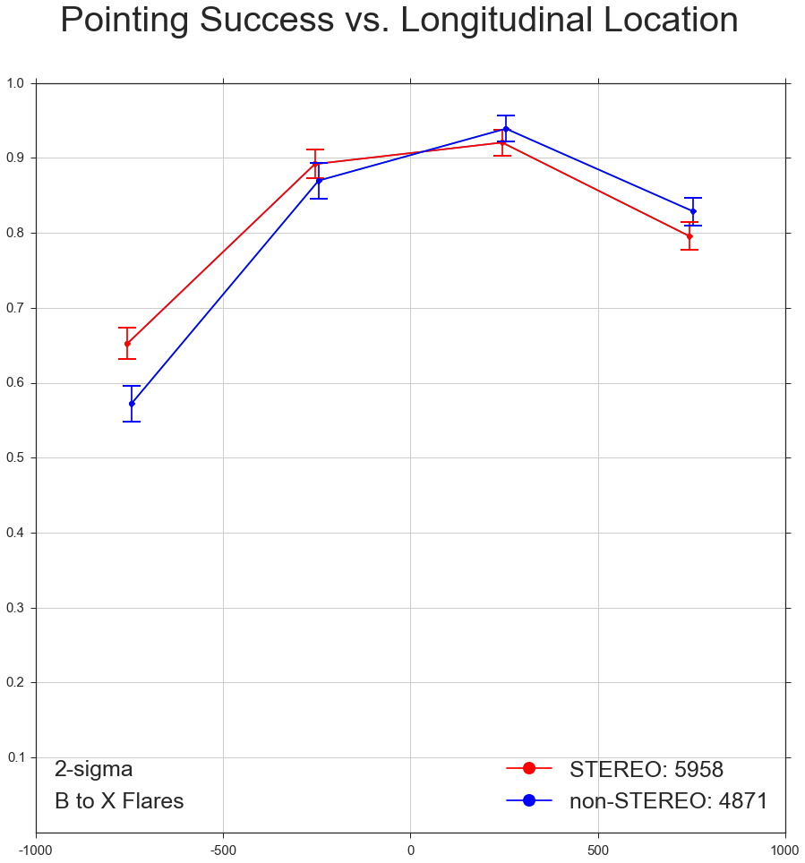
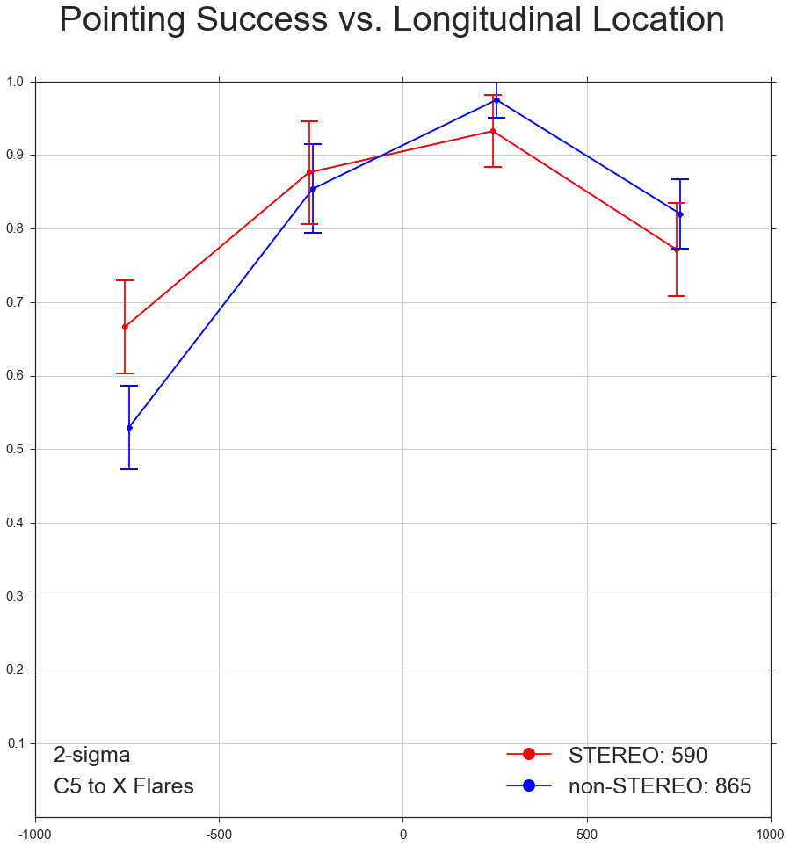
STEREO Analysis
Notes:
I went through several iterations in my analysis of of the effect of the STEREO mission on XRT flare imaging performance. I defined the “STEREO Era” to be from 2009-02-01 to 2013-03-01, approximately the period in which STEREO B’s orbit was between 45 and 135 degrees offset from the Earth’s. For comparison, I used 2013-03-01 to the present as the “non-STEREO Era.” My first few attempts at analysis were flawed such that random events -- such as when 20 flares rated C5 and higher occurred during a single CCD bakeout in 2013 – had too much of an effect on the results. My best solution to this problem was actually to ignore whether or not XRT imaged the flare in question, but rather to use Hinode pointing file information to determine whether the flare occurred within the field of view of the CCD, that way phenomena such as bakeouts, orbital events, and other events that hinder XRT’s performance would not impact the result. Sometimes, however, Hinode points certain places without even the intention for it to be a good FOV for XRT, such as during certain calibration routines or events like momentum wheel maneuvers. Flares that occurred during situations like those are filtered out in this analysis because they do not reflect the ability of the planners to point based on expected solar activity. These graphs were the results of this final iteration of my analysis. They depict the proportion of flares in each region that occurred within the FOV of XRT’s CCD. The left graph is for flares of class B and higher and the right one for flares rated C5 and stronger. Both graphs show a statistically significant increase in east limb performance during the STEREO Era. For flares of class B and higher, there was a small, but statistically significant at a level of 2-sigma, drop in performance on the west limb. However, not only is it minor, but we cannot say with any confidence that such an effect persists into the imaging of more powerful, more scientifically interesting flares. This analysis seems to indicate that the Hinode planners performed better in deciding when to aim at the east limb during the so-called STEREO era, suggesting that the mission did improve flare capturing performance. STEREO A will move into a good position for viewing the east limb in the next few years, and this analysis suggests that it will be worthwhile for Hinode planners to use its data to inform their decisions.

Slide 15
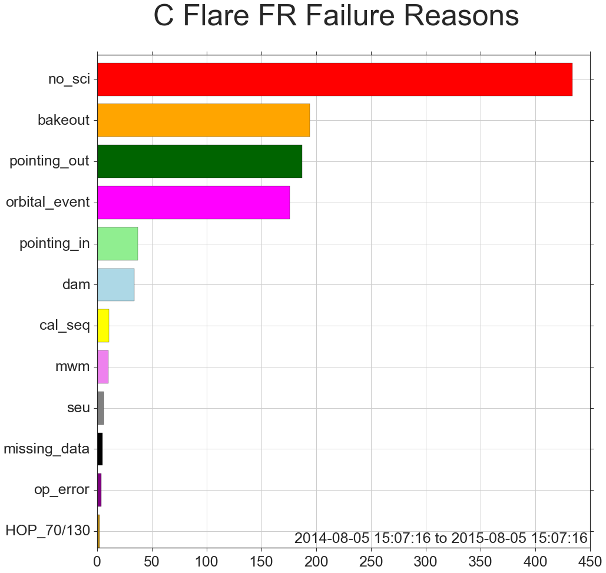
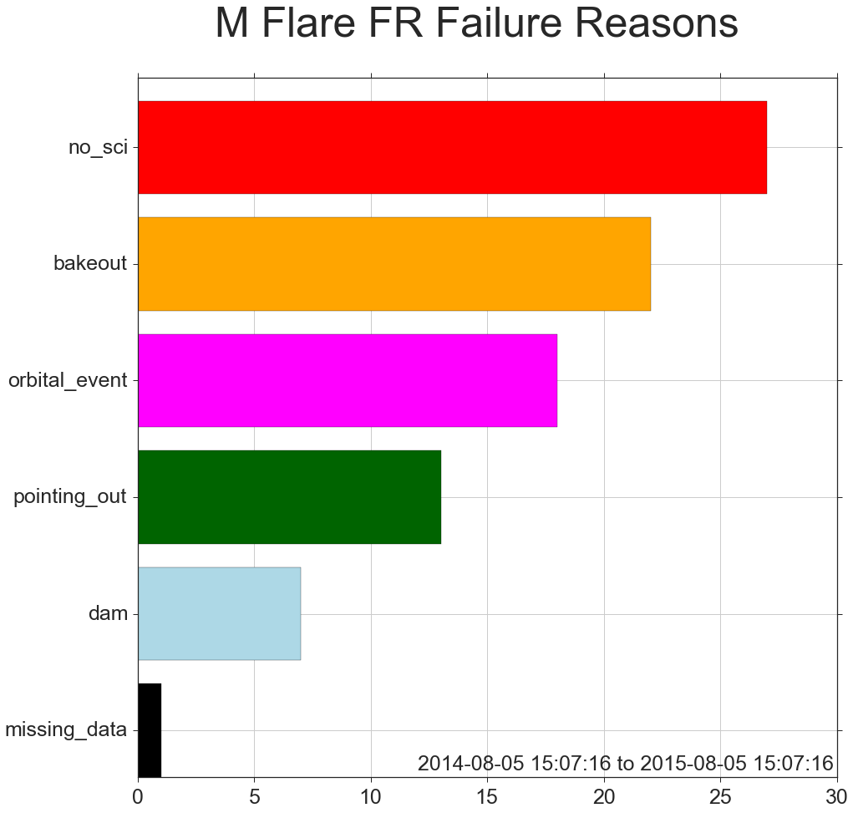
Fld failure analysis
Notes:
These plots show the frequency with which different reasons for flare detection failure occur. Like the failure reasons distribution plots from earlier, these graphs very clearly show that the largest cause for FLD failure is quite simply when no scientific observations are planned. Bakeouts, pointing failures, and orbital events are responsible for the vast majority of the rest of the failures. Note the failure code ‘dam’ that caused a relatively substantial number of M flares to be missed. ‘dam’ stands for debris avoidance maneuver, which is exactly what it sounds like. The effect of these rare maneuvers cannot be improved. Orbital events are similarly unavoidable. For bakeouts, however, it may not be quite as inevitable as it seems. Bakeouts are important because they maintain the high quality of XRT’s data, but it should be investigated if lowering their duration and/or frequency by small amounts would still yield data of sufficient quality. These plots also allow for some encouraging observations, however. Note that a far smaller proportion of M flares were missed because of XRT’s limited duty cycle than was the case for C flares. This indicates that the planners are doing well at deciding when it is important to be observing. Similarly, the better pointing performance for M flares indicates that the planners can identify active regions that are likely to produce powerful flares with a reasonable degree of accuracy. Additionally, note the failure reason ‘pointing_in’ on the C flare plot. This refers to when XRT didn’t take data of the flare but it was still within the FOV of the CCD. Over the last year, none of these failures occurred for M flares, indicating that the FLD patrol algorithm is quite effective.

Slide 16
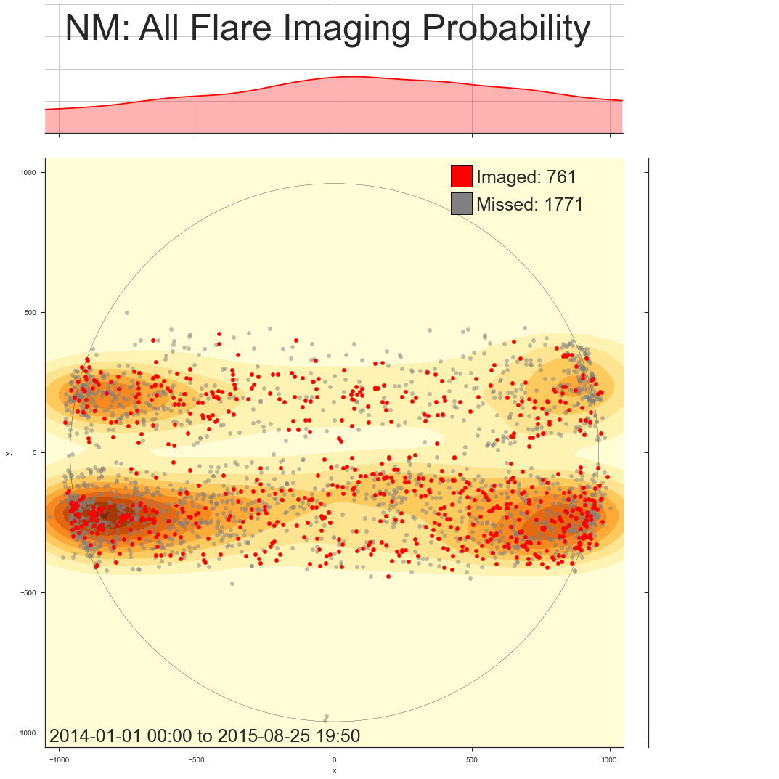
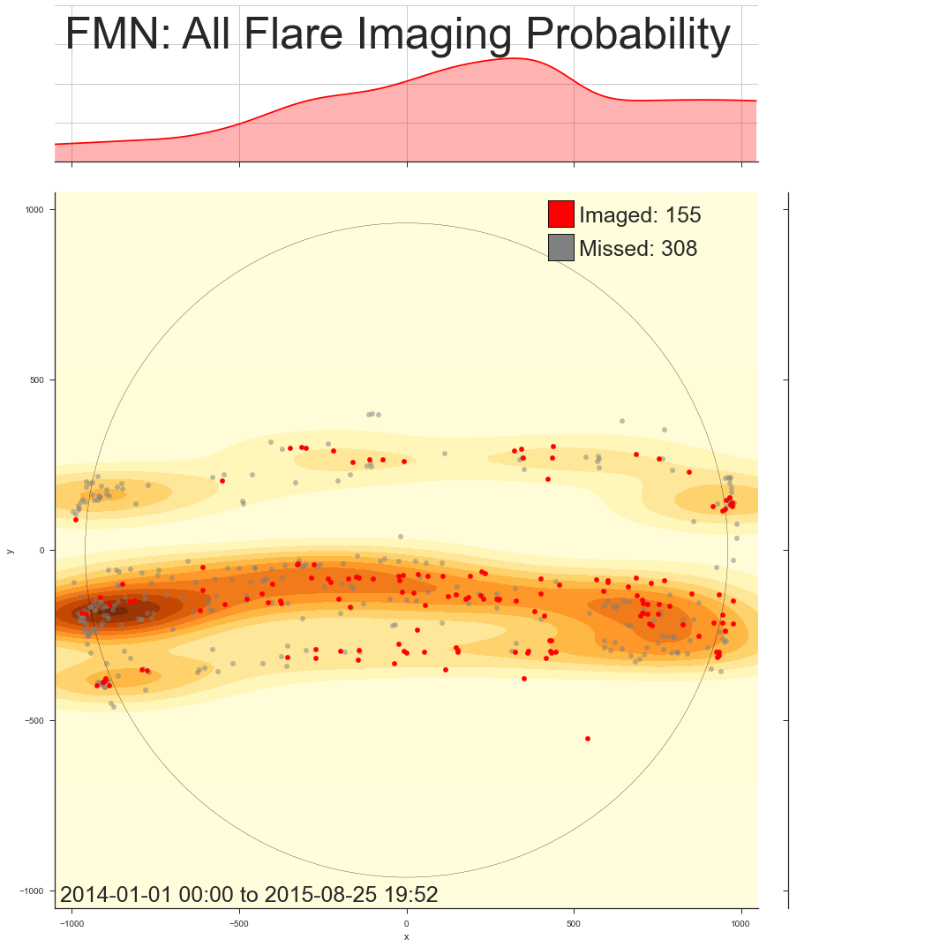
Focus mode analysis
Notes:
As the first step in my comparison of the effectiveness of XRT in imaging flares during focus mode versus normal mode. Both plots are from 2014-01-01 to the present. The figure on the left shows the probability distribution of imaging a flare along the longitudinal axis of the sun for flares that occurred while the spacecraft was in “normal mode,” which is to say, not focus mode. The figure on the right shows the same information but for flares that occurred during “focus mode normal,” which is to say, focus mode while the spacecraft was not in eclipse season. During normal focus mode, XRT captured a larger proportion of flares overall, performing especially well on the western side of the disk. From approximately -500 arcseconds an east, however, focus mode performance fell behind normal performance. These trends notwithstanding, this comparison has to be done in a more quantitative manner in order to draw any conclusions.

Slide 17
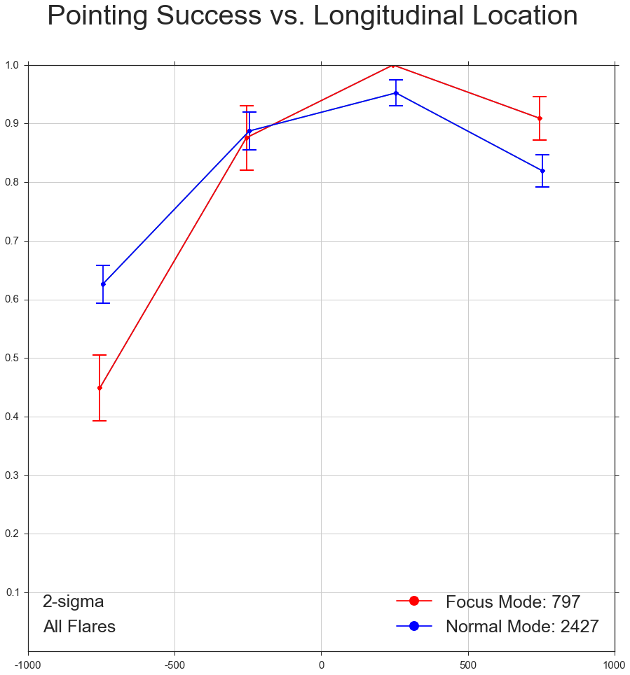
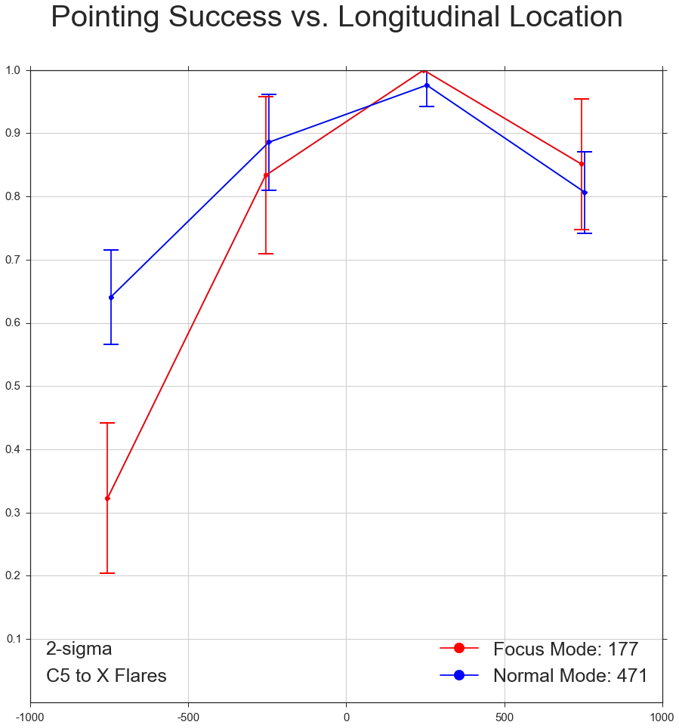
Focus mode analysis
Notes:
Using the same technique as in the STEREO analysis, I broke down by region and determined the proportion of flares in each region for which the flare occurred within the FOV of XRT. These plots both use data from 2014-1-1 to 2015-07-31. Note that it is no longer necessary to restrict the focus mode data to non-eclipse focus mode because this type of analysis isn’t effected by orbital event failures. The left figure is for flares classes B through X, while the figure on the right represents the pointing performance for flares rated C5 and higher. Both plots show significant drops in flare imaging performance on the east limb during focus mode. This drop was 18 percentage points for flares class B and higher and 32 percentage points (50 percent) for flares of classes C5 and higher. The all flares graph on the left suggests that focus mode led to modest improvements in performance in the west, but these do not make up for the eastern performance drop, especially considering that it isn’t even clear if the western improvement exists for the more powerful flares. Overall, pointing performance dropped by 5 percentage points for flares of classes B through X and by 10 percentage points for flares of classes C5 through X.

Slide 18
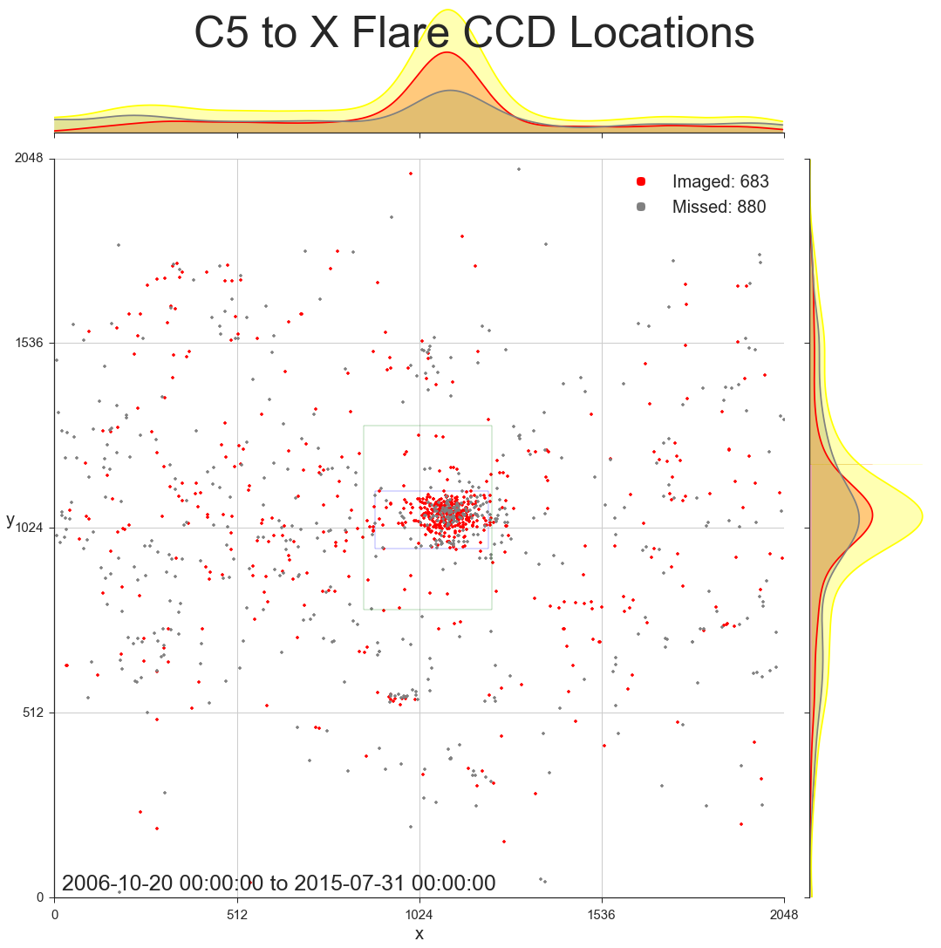
Notes:
I also plotted caught and missed flares in the coordinate system of XRT’s CCD. This plot shows that the Hinode planners are very good at predicting that an active region is of interest. It also demonstrates that SOT (FOV indicated in blue) and EIS (FOV indicated in green) are pointed so that many flares are within their FOVs, even though they are so small compared to XRT’s. This figure doesn’t have any implications for improving XRT’s performance, but it is an interesting perspective on Hinode’s pointing performance that isn’t conveyed by the other plots.

Slide 19
Conclusions
Unmistakable drop in performance at east limb
Pointing failures
STEREO data appears to have helped – can help again
Duty cycle is the primary cause of all FLD failures
Observing during HOP 79/130 routines would have minimal effect
Bakeouts are the second largest cause
Investigate possibility of lowering frequency and/or duration?
FLD algorithm is very effective at identifying M flares
2014-2015 Focus Mode data shows a significant drop in east limb pointing performance
Ending or minimizing the use of focus mode would most likely improve flare imaging performance
Notes:
My XRT performance analysis very clearly demonstrates that flares are missed at disproportionately high rates on the east limb as a result of pointing failures. STEREO seems to have had a positive effect on east limb performance for not only solar flares in general, but also for flares rated C5 and higher. STEREO A data should therefore be taken into consideration by the Hinode planners once the satellite reaches a useful position. However, even more common than pointing failures, a lack of data collection was the most frequent reason for FLD failures over the last year. Thankfully, however, the duty cycle was responsible for a far smaller fraction of FLD failures for powerful flares than for weaker ones. Attempting to improve performance by observing during the HOP79 or HOP130 routines would have a minimal effect because these routines make up such a small portion of the duty cycle failures. Another part of the duty cycle problem, which I treated as a separate category in my analysis, is missing flares due to bakeouts. Bakeouts were the second most common FLD failure reason in the last year, and any possible reduction in the frequency and/or duration of these procedures would be beneficial. I also found that the FLD algorithm is very good at identifying powerful flares that occur within the FOV of the CCD. There wasn’t a single M flare in the last year that was missed despite being in the full CCD FOV during normal XRT operations. My analysis of the 2014 to 2015 Focus Mode data shows that, once the effects of chance are filtered out, there was a significant drop in pointing performance on the east limb across flares of all strengths.

